Slide 1





Tunisian Real Estate
MLOps
Notes:
1

Slide 2


01
1. Project Overview & Architecture
02
2. Notebook 01 (EDA): Overview
03
3. Notebook 01: Cleaning & Target Transformation
04
4. Notebook 01: Feature Engineering & Encoding
05
5. Notebook 02 (Modeling): Overview
06
6. Model Selection & Hyperparameters
07
7. Performance, Diagnostics & Geo Errors
Notes:
2

Slide 3















Project Overview
End-to-End Flow
A reproducible daily pipeline that predicts Tunisian apartment sale prices and supports renovation ROI decisions.
Scrape
Geo-enrich
Goal
Predict SalePrice with business-friendly accuracy (avg error ±22.4%)
EDA/feature pipeline
Automate ingestion → training → promotion to production
Model training
Explain price drivers (location, size, amenities)
Data at a glance
MLflow registry
Raw Listings
Clean Samples
Streamlit App
Incremental currently 4506
Incremental 3665
Raw Columns
Model Features
65
371
Notes:
3

Slide 4












4-Layer Architecture & Daily Run
Separation of concerns ensures repeatability, traceability, and easy deployment.
Daily DAG (High Level)
Layer 4
MLflow
Experiment tracking + model registry
scrape
geo
dvc repro (01_EDA)
dvc repro (02_Modeling)
registry promotion
dvc push
Layer 3
DVC
Data + artifact versioning
Operational notes
Artifacts tracked
•
Max active runs: 1
•
Dataset CSV
Layer 2
•
Retries with backoff
•
Train/test pickles
Airflow DAG
•
metrics.json
03:00 UTC daily schedule, retries
•
model.pkl
Layer 1
Docker
Reproducible environment
Notes:
4

Slide 5






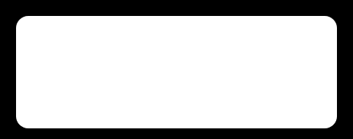







Notebook 01 EDA Overview
Transform raw scraped listings into clean, encoded, scaled train/test artifacts.
Data Transformation Pipeline
Key EDA Themes
Raw CSV
Missingness decisions (drop vs impute vs flag)
Target distribution repair (log transform)
Clean / Impute
Outlier + leakage handling
Geographic signal extraction
Engineer
Encode / Scale
Saved Artifacts
X_train
X_test
y_train
Split
y_test
feature_columns
Pickles
Notes:
5

Slide 6

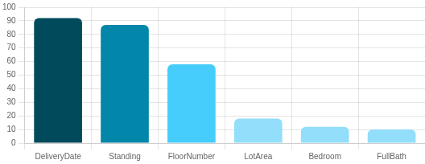
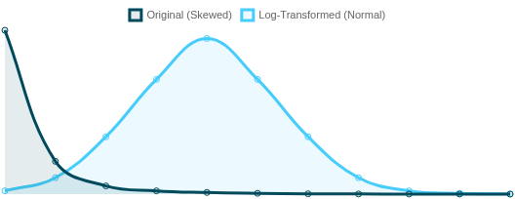



EDA Deep Dive Cleaning Decisions
Missingness by Column (%)
Target Transformation: SalePrice vs Log_SalePrice
Missing Data Strategy
Target Transformation
Outlier & Leakage Controls
DeliveryDate: 92% missing → DROP
SalePrice skewness: 41.81 → 1.86 after Log_SalePrice = log1p(SalePrice)
Price floor/ceiling: 40,000 → 6,000,000 TND (11 rows removed)
Standing: 87% missing → fill 'Unknown' (missingness is signal)
Normalizes extreme right-skew for linear model compatibility
Drop leakage: PricePerSqm (calculated from target)
FloorNumber: 58% missing → create FloorNumber_Missing flag + impute median
Caps: Bedroom ≤10, FullBath ≤10, LotArea ≤1,000 sqm
Other numerics: <20% missing → city-level median imputation
Notes:
6

Slide 7


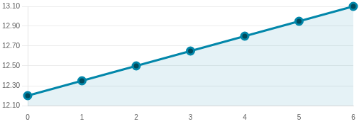




Feature Engineering and Encoding
Premium Features Count vs Median Log_SalePrice
Engineered features:
Premium_Features_Count (0–6): sum of luxury amenities (pool/duplex/sea view/elevator…)
Geo_Cluster: K-Means on lat/lon with k=6 (macro-regions)
FloorNumber_Missing: preserves missingness signal
Feature pruning (multicollinearity/leakage examples):
Drop SalePrice (keep Log_SalePrice)
Drop AmenityScore (redundant vs Premium_Features_Count)
Geo_Cluster: 6 Macro-Regions
Drop lat/lon (use Geo_Cluster + City)
Encoding + scaling:
One-Hot Encoding on City/Neighborhood/Standing/Condition/Type (drop_first=True)
Feature expansion: 40 → 371 columns
StandardScaler for numeric features
Cluster 1
Cluster 2
Cluster 3
Cluster 4
Cluster 5
Cluster 6
Notes:
7

Slide 8


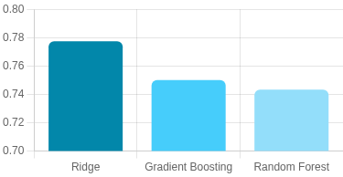
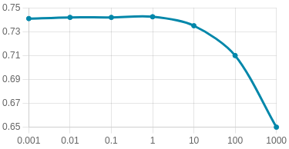
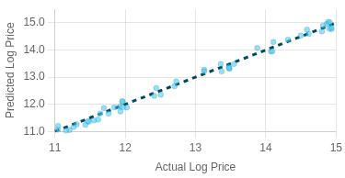
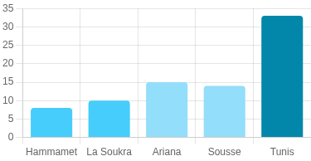
Notebook 02 Modeling Results
Ridge Regression was the champion model for high-dimensional sparse OHE data.(Can be Changed )
Models Evaluated
Ridge Regression (L2): best generalization
Model Comparison (R² Score)
Validation Curve (Alpha vs CV R²)
Random Forest: underperforms on sparse one-hot features
Gradient Boosting: underperforms vs Ridge
Hyperparameter Tuning
Grid: alpha ∈ [0.001, 0.01, 0.1, 1, 10, 100, 1000]
Best alpha = 1.0 (default)
Performance (Test Set)
Actual vs Predicted Scatter (Ridge)
Geo Error Heatmap by City (%)
R² = 0.7774
RMSE (log) = 0.278; MAE (log) = 0.202
Avg error ≈ ±22.4%
Notes:
8

Slide 9


Thank You
Notes:
9

